Slide 1
Error budget figures

Slide 2
Practice Problem
Eyepiece Imaging Optics
Focusing Optics
Aberration Correction Optics

Slide 3
Telescope Focusing Optics
35
26
25
R50
1
7
R10
8
20
4
10
2
10
12.5
40

Slide 4
Requirements

Slide 5
Stack path
A
35
y
26
25
z
B
x
R50
1
y
R10
y
y
PATH CS0 → CS3
7
CS0, CS3
8
z
20
CS1
z
z
PATH CS0 → CS1
x
CS2
x
4
x
10
PATH CS0 → CS2
2
10
12.5
40

Slide 6


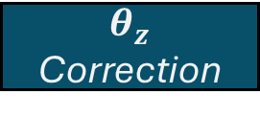
y
Ra
Rcae
y
y
$θ_{z}$ Error
x
x
1un
z
$$Origin$$
z
x
1un
z
$θ_{z}$ Correction
Y Error

Slide 7


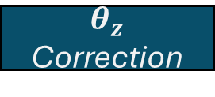
Ra
y
Rcae
y
$θ_{z}$ Error
x
1un
$$Origin$$
z
z
x
$θ_{z}$ Correction
Y Error

